Slide 1
Transcriptome Analysis

Slide 2


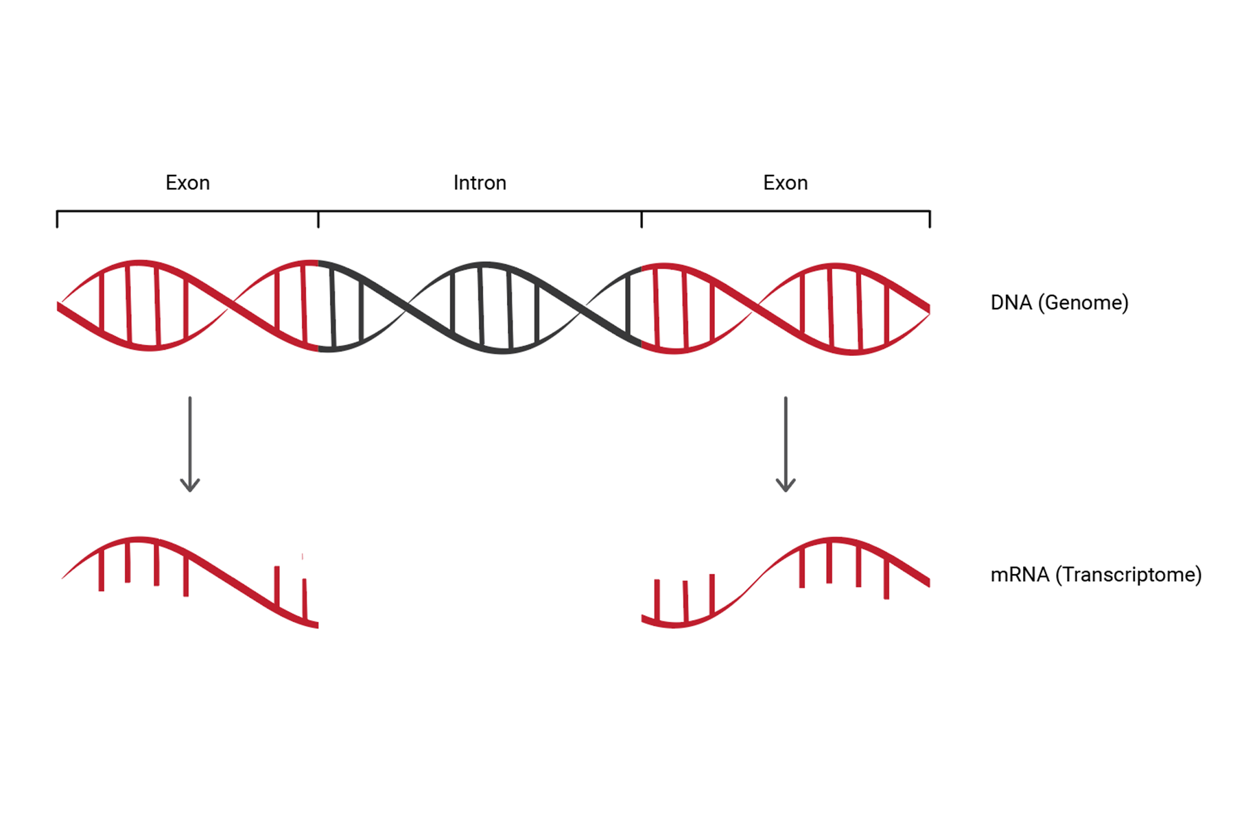
Transcriptome
Collection of all RNA in a system
Gives idea about which genes are actually being transcribed

Slide 3
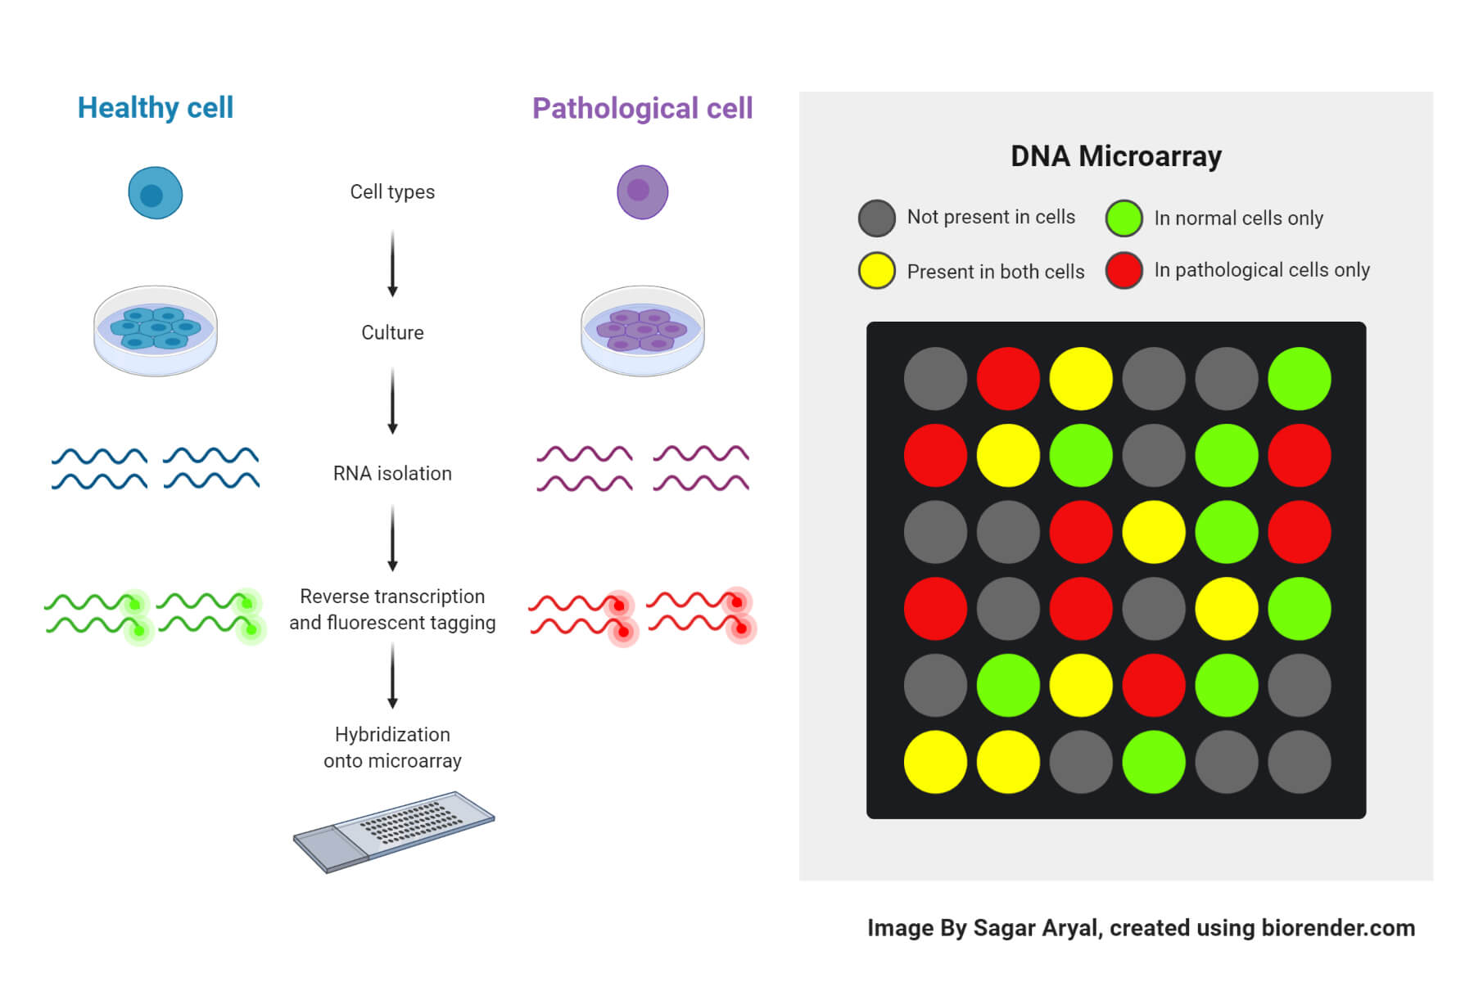
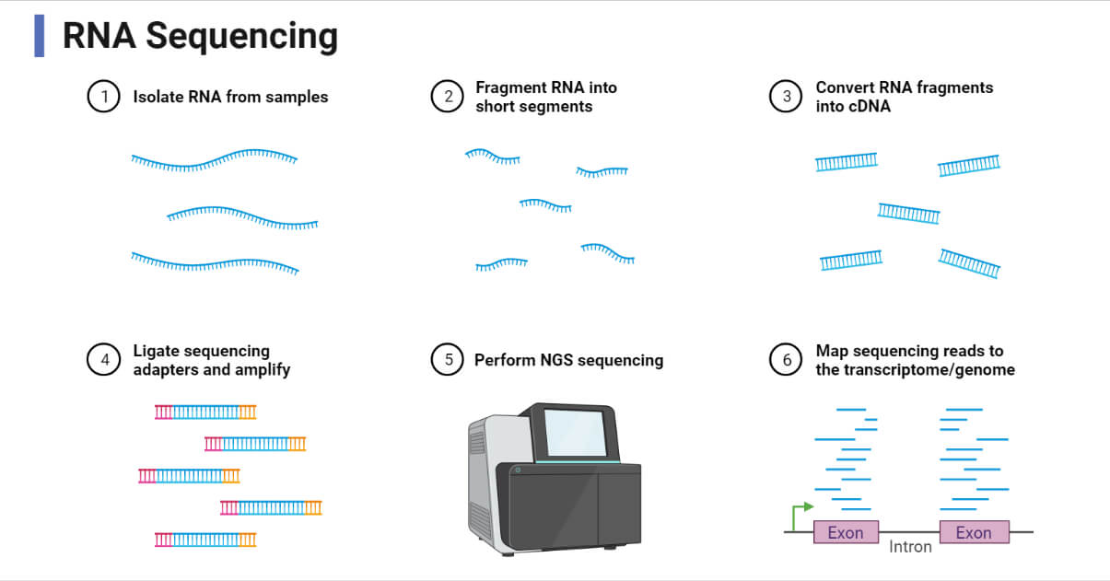
Transcriptome
Microarray v RNA-seq
Both give idea of genes being up or downregulated under certain conditions
RNA-seq is technique of choice
Can identify non-coding RNAs
Can identify splice variants

Slide 5
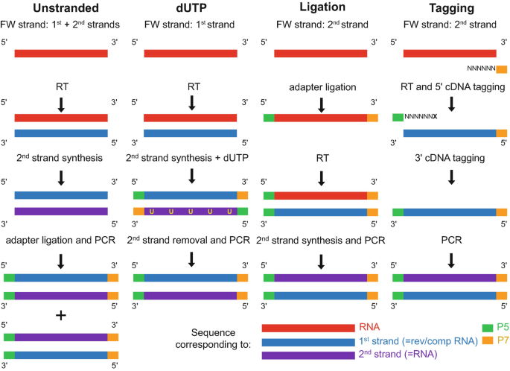
Advances in RNAseq Technology
Strand-specific RNA-seq
Best way to identify noncoding or antisense RNA
Can be technically challenging and time consuming

Slide 6

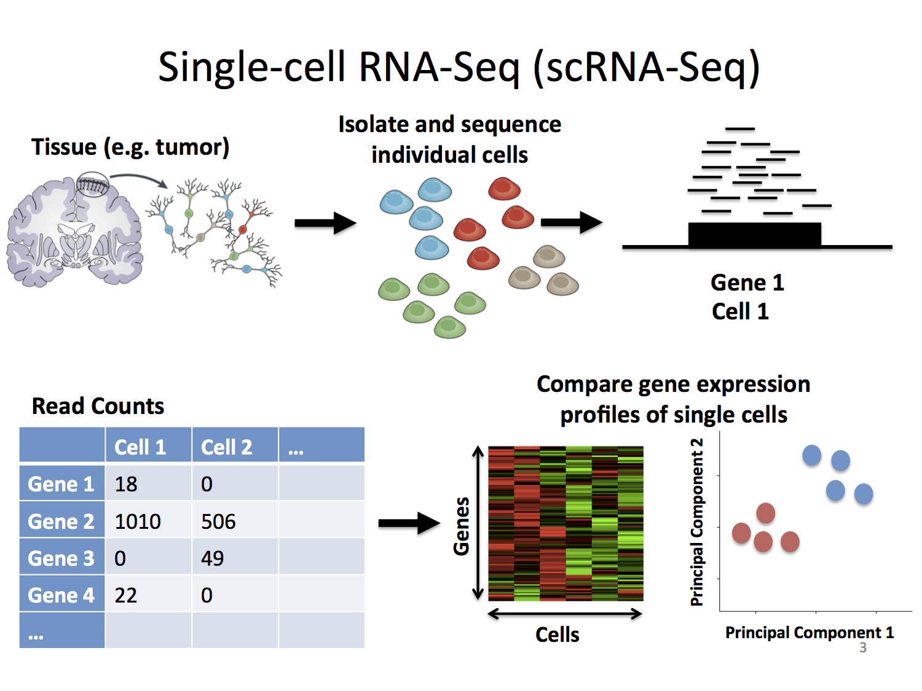
Advances in RNA-Seq Technology

Slide 7
Analysis of RNA-seq Data
5 steps (and lots of different programs):
1) Preprocessing
2) Read alignment
3) Transcriptome reconstruction
4) Expression quantification
5) Differential expression analysis

Slide 8
Preprocessing
Assess quality of raw data
Trim adapters
Remove low quality ends of reads
Programs include FastQC, HTQC, FASTX-Toolkit, FLEXBAR
This step has already been done on the tutorial data

Slide 9
Read Alignment
Can be done in 2 ways
1) Unspliced – if using transcriptome as reference
Limited to known exons/splice variants
Done if whole genome sequence is unavailable
MAQ, BWA, Bowtie
2) Spliced – if using whole genome as reference
RNA-seq reads aligned to genome
Allows ID of novel transcripts
TopHat, HiSat2, STAR, SNAP
We will be using HiSat2 for Spliced Alignment

Slide 10
Transcriptome Reconstruction
Can also be done in 2 ways
1) reference-guided approach
Aligning to genome (as in previous step)
Assembly of overlapping reads
Good for well-annotated systems
Cufflinks, Scripture, StringTie
2) reference-independent approach
Builds consensus reads without reference
Done when no reference genome available
Trinity, Oases, transABySS
Computationally intensive
We are doing reference-guided using StringTie

Slide 11
Expression Quantification
2 types of analyses
Both have to be normalized to account for gene length and sequencing depth
Gene-level quantification
Does not take into account splice variants
Is simpler
Isoform-level quantification
Can be done with transcriptome, whole genome, or de novo assemblies
We will use StringTie

Slide 12

Expression Quantification
In StringTie, abundance is estimated using maximum likelihood
To normalize, calculate Reads/Fragments Per Kilobase per Million mapped reads (RPKM/FPKM)
RPKM/FPKM = (10^9 * C)/(N * L), with
C = Number of reads/fragments mapped to a gene
N = Total mapped reads in the experiment
L = gene length in base-pairs for a gene

Slide 13
Differential Expression
Comparison of relative abundance of transcripts in different samples
Have to normalize samples against one another

Slide 14
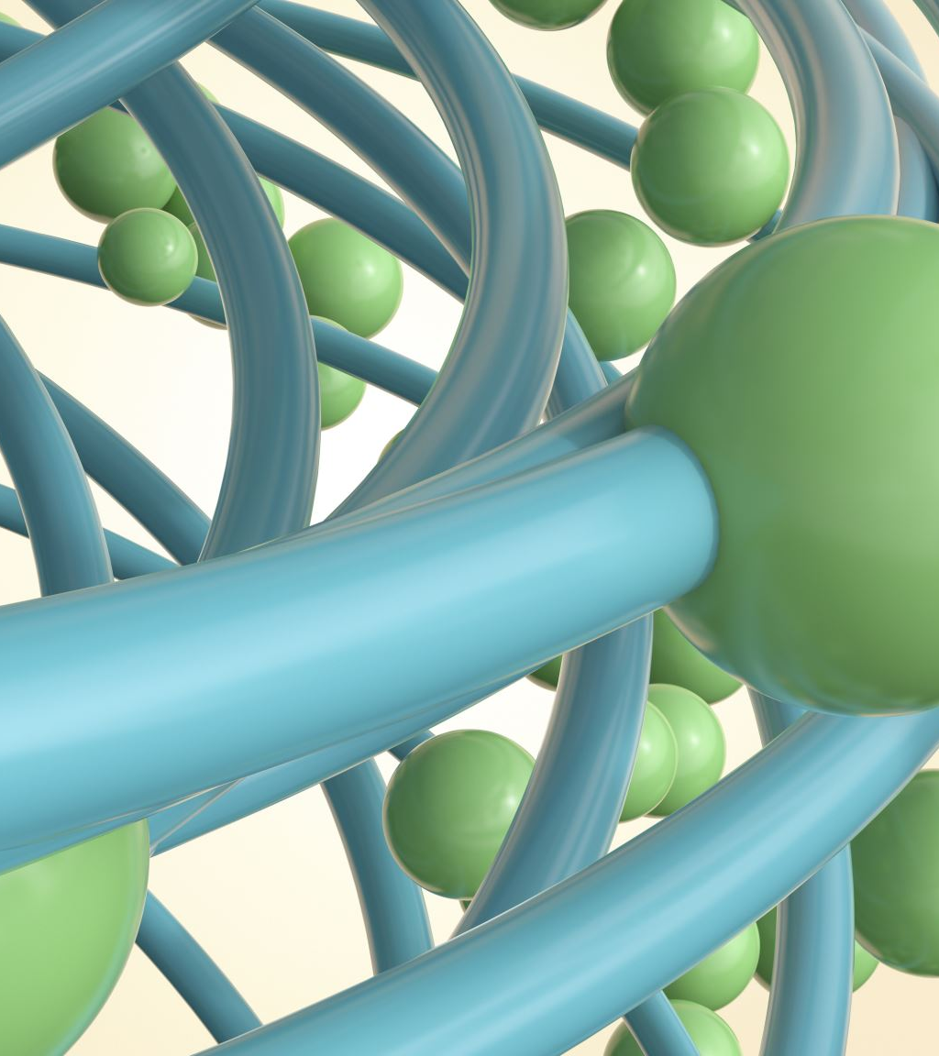
Visualize Differential Expression
We will use Ballgown package in R
Allows visualization of FPKM per sample
Compare expression values
Identify most significantly differentially expressed genes
Compare expression of individual genes in each sample

